Slide 1


Heart Disease Diagnostic Analysis
Project 2

Slide 2
Introduction
Problem Statement:
Health is real wealth in the pandemic time we all realized the brute effects of covid-19 on all irrespective of any status. You are required to analyze this health and medical data for better future preparation.
Do ETL: Extract- Transform and Load data from the heart disease diagnostic database You can perform EDA through python. The database extracts various information such as Heart disease rates, Heart disease by gender, by age.
You can even compare attributes of the data set to extract necessary information. Make the necessary dashboard with the best you can extract from the data. Use various visualization and features and make the best dashboard Find key metrics and factors and show the meaningful relationships between attributes. Do your own research and come up with your findings.

Slide 3
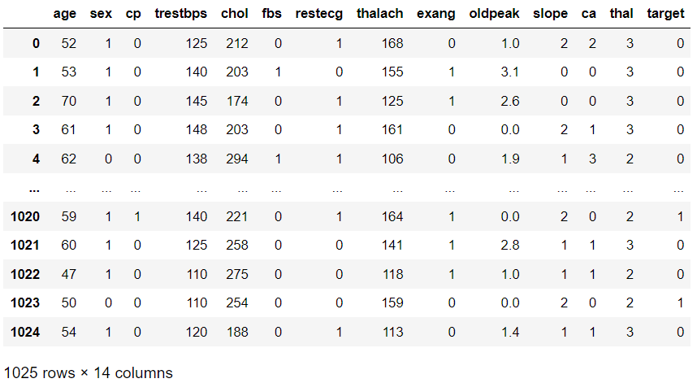
Heart Disease Data Analysis
Amazon Sales data preview:

Slide 4
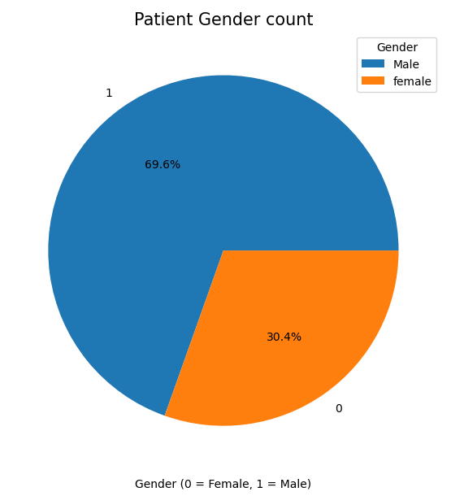
Heart Disease Data Analysis
Patient count gender wise:
The count of patients male = 69.9% & Female = 30.4%

Slide 5
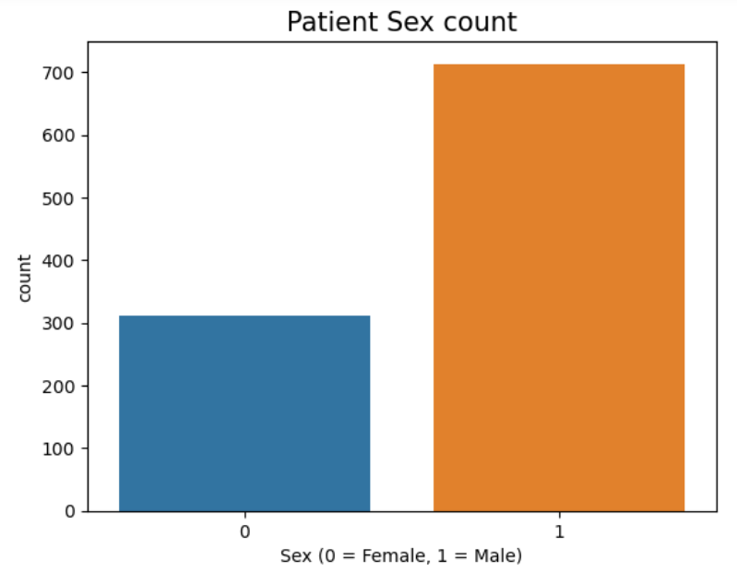
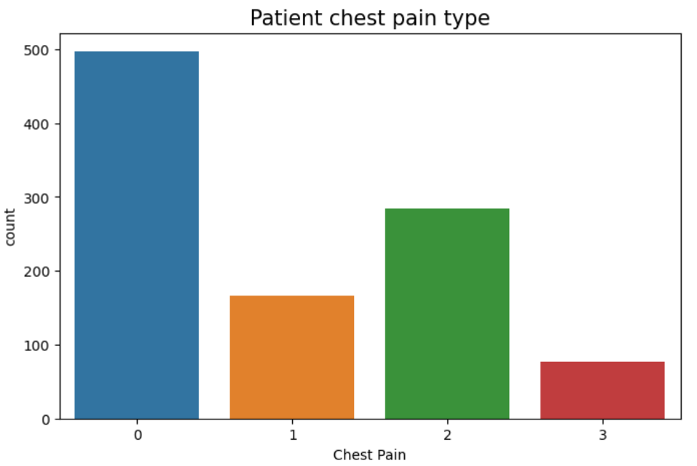
Heart Disease Data Analysis
Patient sex count & Patient chest pain type:
The count of patients male = 725 & Female = 300
The patients chest pain category ‘0’ is highest count in the dataset.

Slide 6
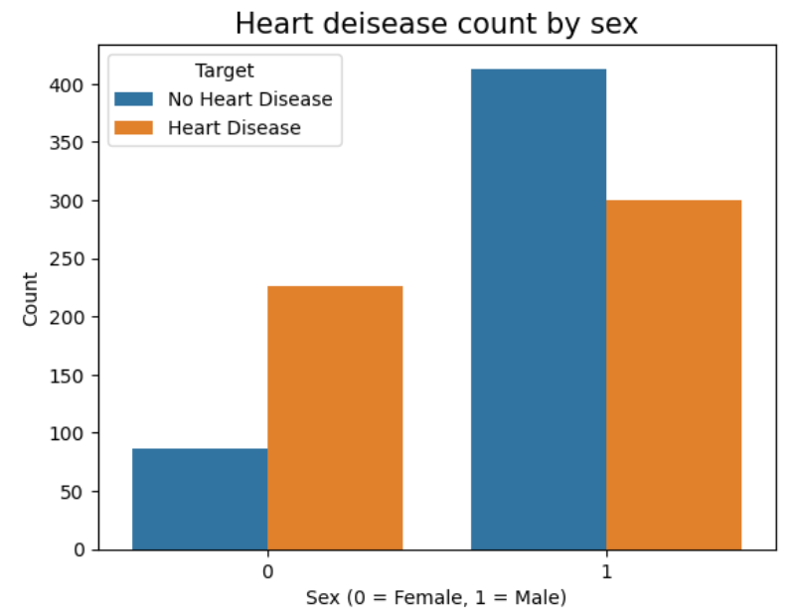
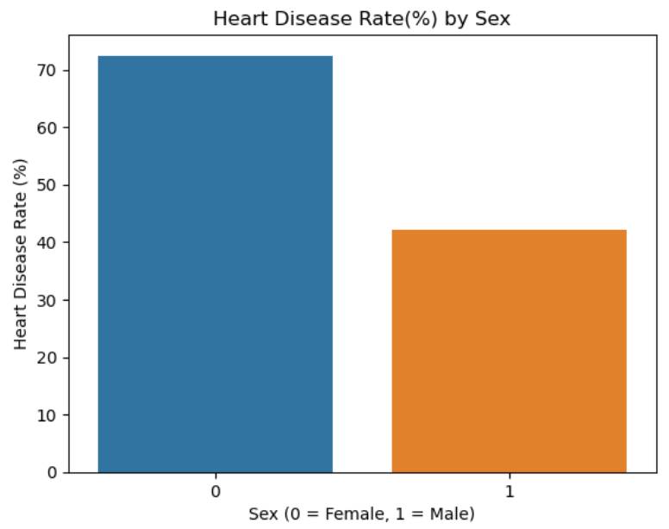
Heart Disease Data Analysis
Heart disease count by Sex & Heart disease rate(%) by sex:
Heart disease count gender wise & percentage(%) wise.
Male patients are having lesser heart disease 41 %. Female patients 72%.

Slide 7
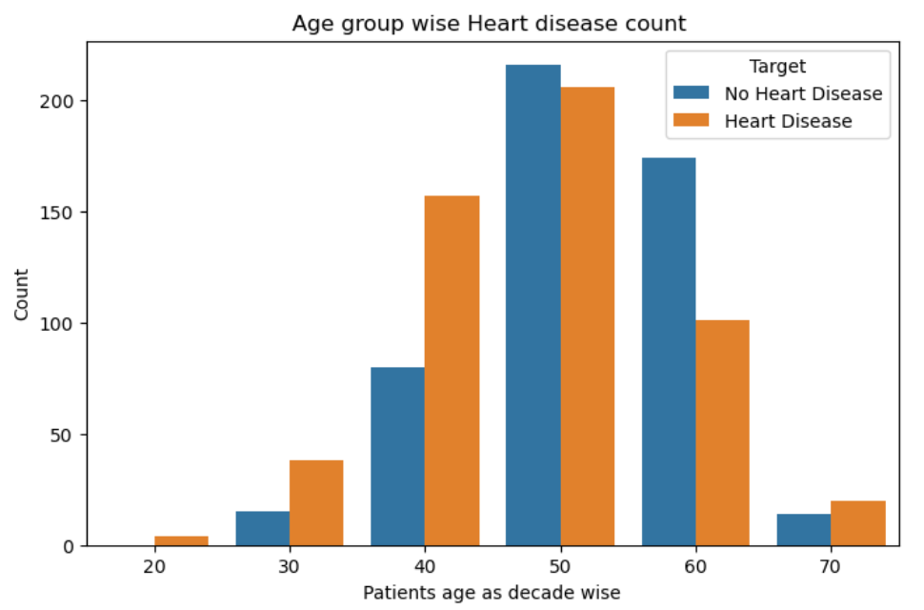
Heart Disease Data Analysis
Age group wise heart disease count:
41 to 50 age patients are mostly having heart disease.

Slide 8
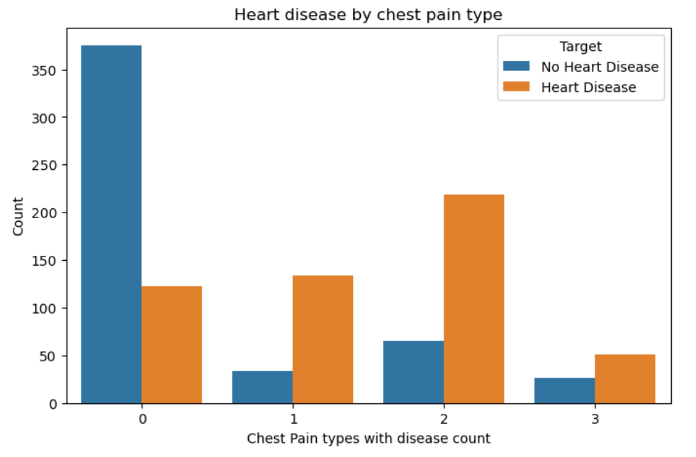
Heart Disease Data Analysis
Heart disease by chest pain type:
The patients with category 2 chest pain is higher heart disease rate.

Slide 9
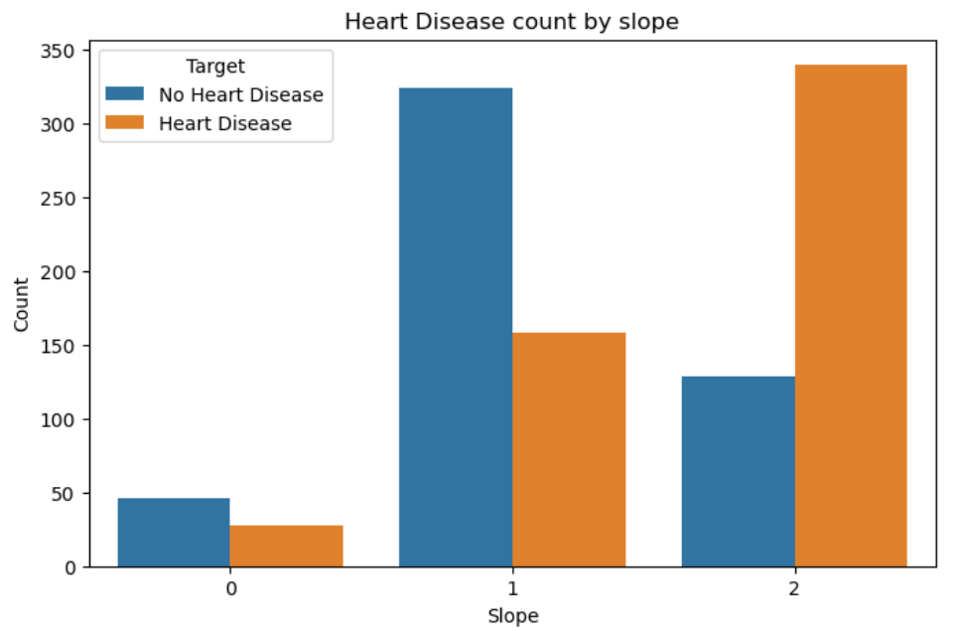
Heart Disease Data Analysis
Heart disease count by slope of the peak exercise ST segment:
Patients with slope category 2 is having higher chest pain count

Slide 10
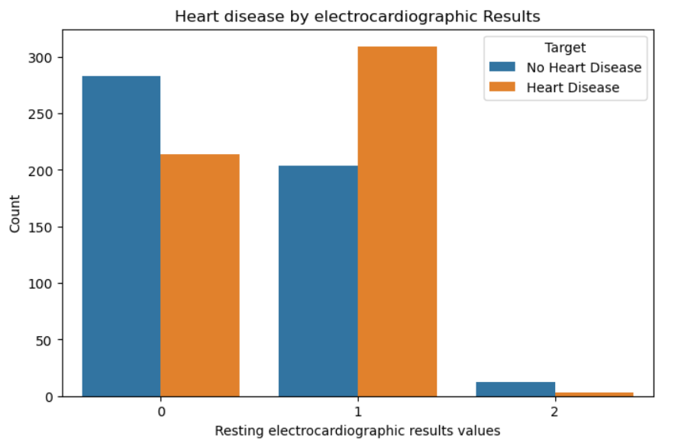
Heart Disease Data Analysis
Heart disease by electrocardiographic:
By electrocardiographic results category 1 is having higher heart disease count

Slide 11
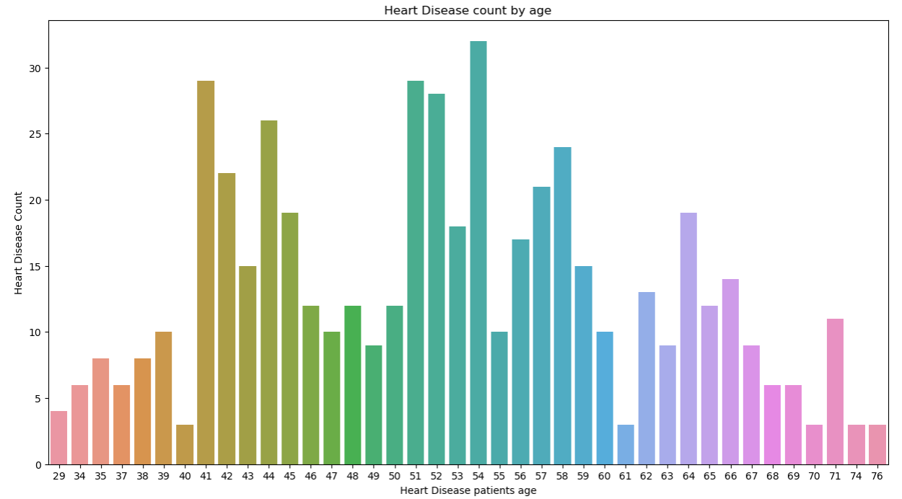
Heart Disease Data Analysis
Heart disease count by age wise:
Patients with age 41,51 &54 is having higher heart disease count

Slide 12
Thank You

